Slide 1



X
HOME
ABOUT US
MORE
Final Project
Business Intelligence Analyst
Virtual Internship Experience
2025

Slide 2





HOME
ABOUT US
MORE
Hello , I am Wulan Nur Widyawati
Currently a 4th-year Information Systems student at Gunadarma University. My keen interest in Data and Business Analyst has driven me to continuously explore and learn about the envolving landscape in this field.
Passionate about data-driven decision-making, I focus on improving my skills in data visualization and business intelligence to create impactful insights.
About Me
@wulannwdyt
2025
wulannurwidyawati
wulannw

Slide 3

X
HOME
ABOUT US
MORE
About the Program
In this project-based internship program, I learned about the role of a Business Intelligence Analyst at Bank Muamalat, including how to solve problems, work and carry out projects aligned with the company's activities.

Slide 4

X
HOME
ABOUT US
MORE
Company Overview
PT Bank Muamalat Indonesia Tbk is bank that runs its business based on the first sharia principles in Indonesia. Curently, Bank Muamalat continues to innovate by issuing sharia products such as sharia insurance, sharia funds and sharia multifinance.

Slide 5

HOME
ABOUT US
MORE
Topic
>
>
>
Project Background
Datasets
Challange

Slide 6
HOME
ABOUT US
MORE
Project Background
As Business Intelligence Analyst Intern at Bank Muamalat, the tasks I carried out involved a series of challanges that required a deep understanding of data and strong analytical skills. One of my main projects involved evaluating Bank Muamalat business performance from 2020 to 2021. Below are the tasks:
Determine the Primary Key
2. Determine the Relationship Table
Virtual Internship Experience
3. Create Master Table
4. Data Visualization Using Looker
5. Business Recommendation

Slide 7

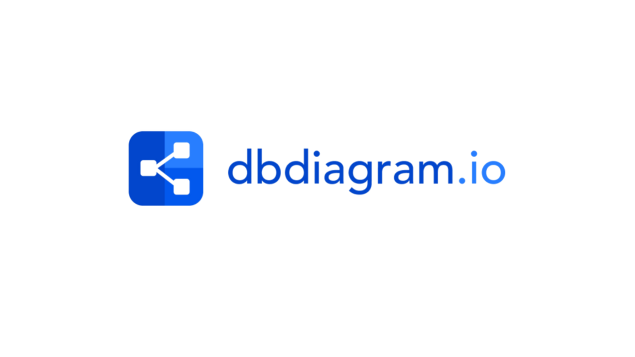

HOME
ABOUT US
MORE
Tools Used
Virtual Internship Experience

Slide 8
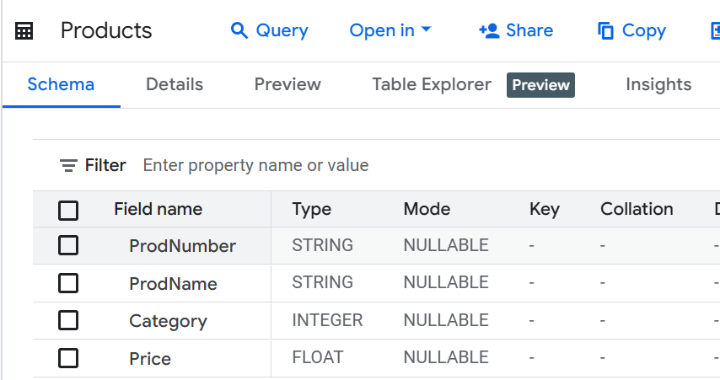
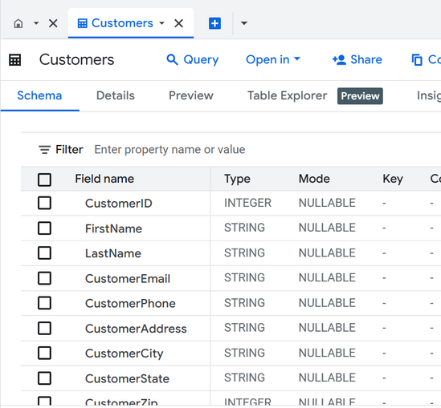
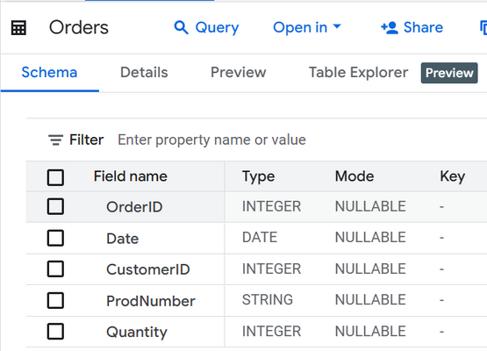
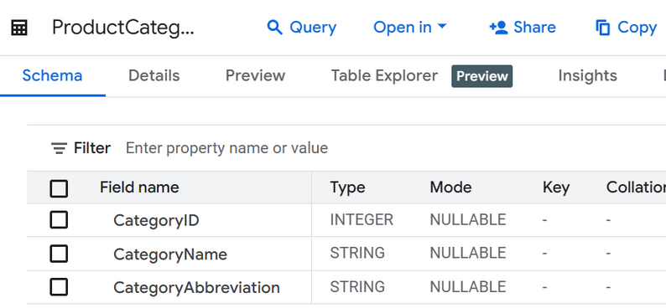
HOME
ABOUT US
MORE
Datasets
Virtual Internship Experience
The dataset sourced from Rakamin contains table information on orders, product categories, products, and customers across various countries from January 1, 2020, to December 31, 2021. It comprises 339 rows and 22 columns, derived from the combination of four tables. As part of a business intelligence analysis, this dataset is utilized to assess the company's performance through a case study involving five challenges.

Slide 9
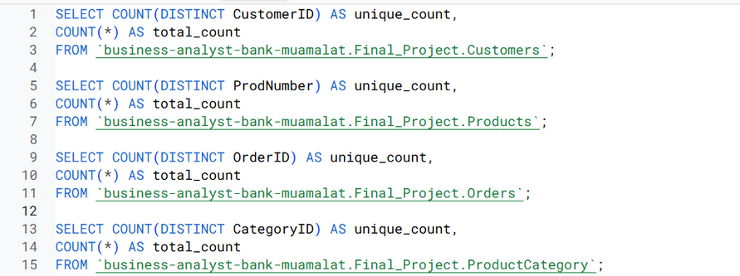
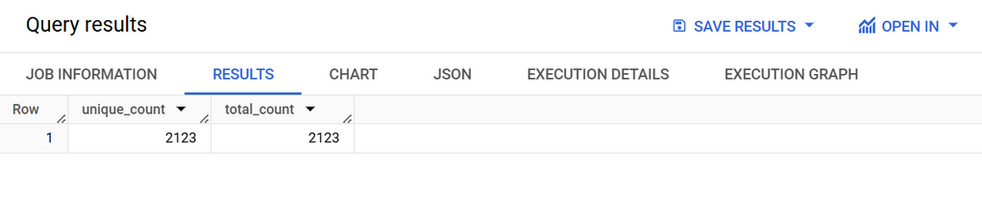
To determine the uniqueness of each attribute in a table, use the following SQL query to calculate the number of unique values and the total number of records:
HOME
ABOUT US
MORE
CustomerID is the Primary Key for the Customers table.
ProdNumber is the Primary Key for the Products table.
OrderID is the Primary Key for the Orders table.
CategoryID is the Primary Key for the ProductCategory table.
Challange 1 : Determine the Primary Key
If the number of unique values is equal to the total number of records, then the attribute can be considered as a Primary Key.
Check here to see

Slide 10
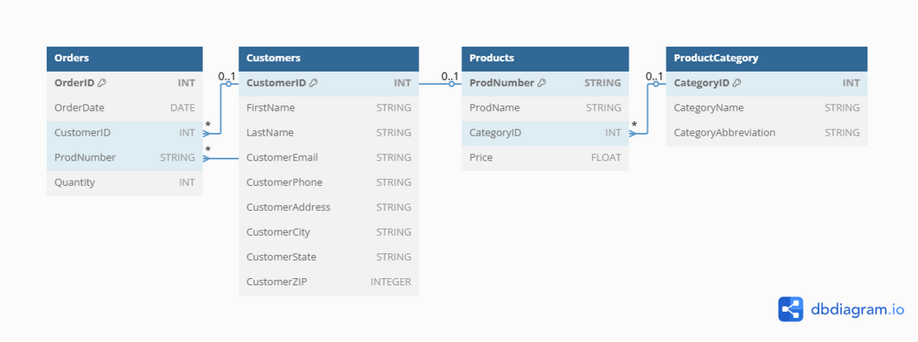
HOME
ABOUT US
MORE
Table relationships refer to the connections between tables established by linking a primary key field to a field with the same name in another table, which is commonly referred to as a foreign key. A foreign key is a field that is not a primary key but serves as the primary key in another table.
The Customers table has a one-to-many relationship with the Orders table, using the key pair: Customers.CustomerID = Orders.CustomerID.
The Orders table has a many-to-many relationship with the Products table, using the key pair: Orders.ProdNumber = Products.ProdNumber.
The Products table has a one-to-many relationship with the ProductCategory table, using the key pair: Products.CategoryID = ProductCategory.CategoryID.
Challange 2 : Determine the Relationship Table

Slide 11
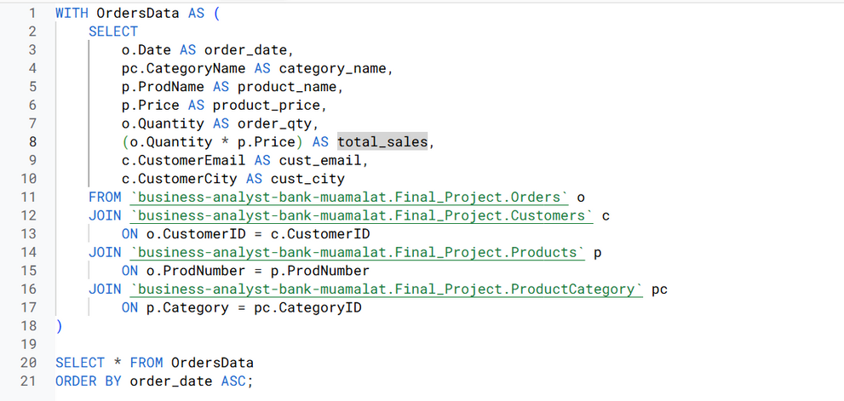
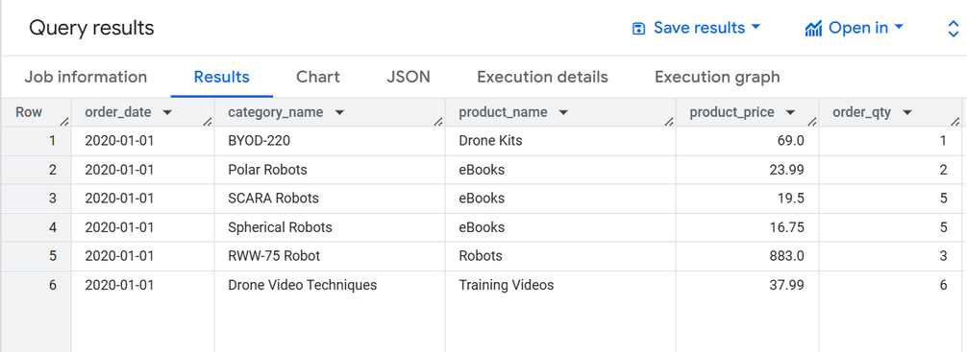
HOME
ABOUT US
MORE
The master query table is created in Google BigQuery using a Common Table Expression (CTE), as shown in the query. The CTE helps structure the query by first defining a temporary result set before retrieving the final dataset. The table is designed to display columns such as order date, category, product, product price, quantity, customer email, customer city, and total sales, where total sales are calculated using multiplication within the CTE. The query utilizes INNER JOIN within the CTE to combine tables based on matching data fields across different tables, ensuring efficient data integration.
The final result from the CTE forms a Master Table, which is stored in CSV format. This CSV file is then used to create dashboards in Looker Studio for data visualization and analysis.
Challange 3 : Create Master Table
Check here to see

Slide 12
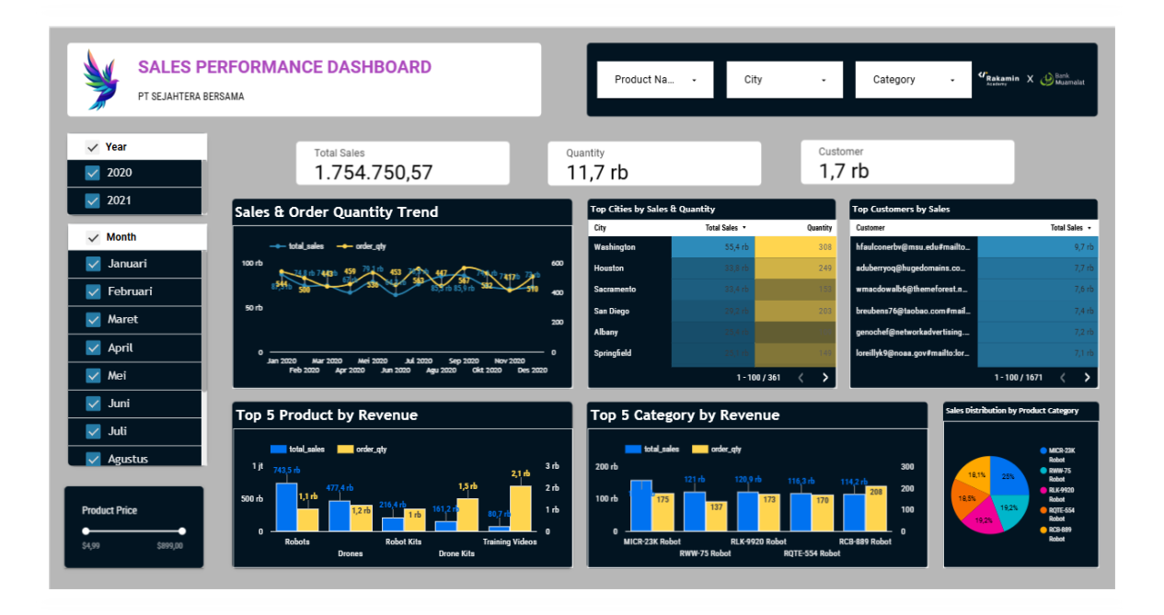
HOME
ABOUT US
MORE
Challange 4 : Data Visualization
Dashboard

Slide 13
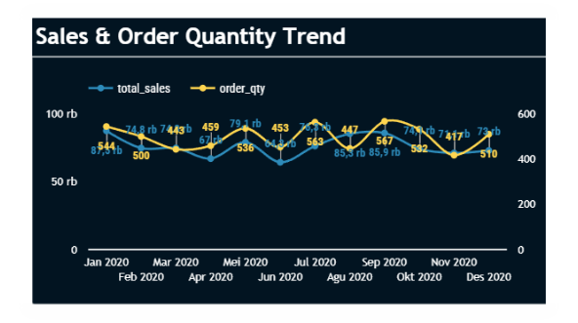
Insight
HOME
ABOUT US
MORE
Based on the sales trend from January 2020 to December 2021, total sales tended to decline despite fluctuating each month. The peak sales occurred in June 2021, with 95,401 products sold, while the lowest sales were recorded in October 2021. Overall, total sales reached Rp1,754,750.57 with 11.7 thousand transactions from 1.7 thousand customers.
Challange 4 : Data Visualization

Slide 14
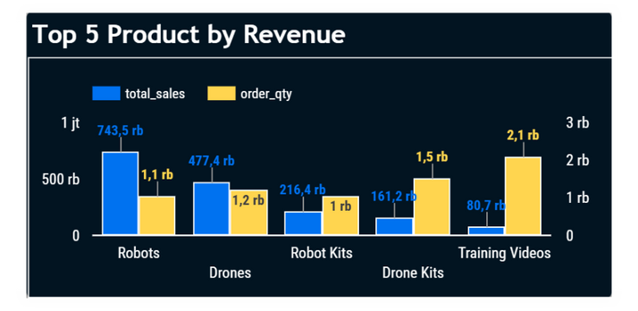
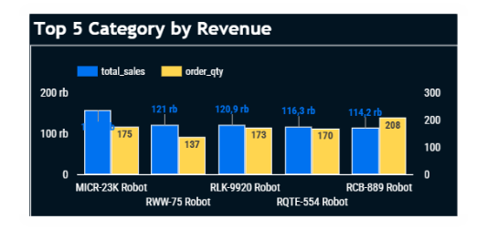
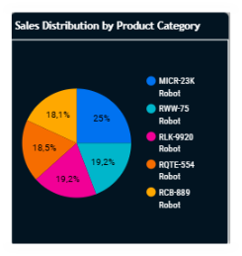
Insight
HOME
ABOUT US
MORE
Robots lead in revenue generation, with 743.5K in total sales, significantly outperforming other products. The MICR-23K Robot is the top category contributor, accounting for 25% of total sales. Training Videos have the highest order quantity (2.1K) but lower revenue (80.7K), suggesting a high demand for low-cost products.
MICR-23K Robot dominates sales (25%), while other categories like RWW-75 and RLK-9920 Robot have balanced contributions (19.2%). RCB-889 Robot has the smallest share (18.1%), despite a high order quantity.
Challange 4 : Data Visualization

Slide 15
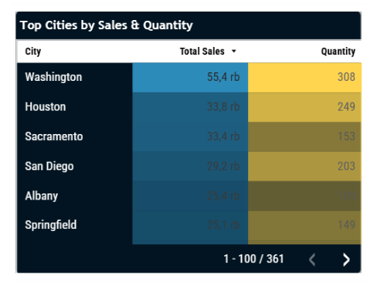
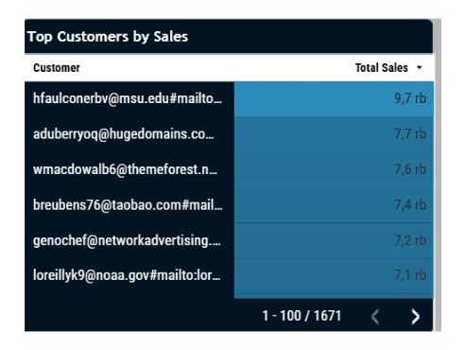
Insight
HOME
ABOUT US
MORE
Washington leads in both revenue and order quantity (55.4 rb sales, 308 orders), indicating strong demand and purchasing power in this city. Houston and Sacramento have similar sales (~33.8 rb & 33.4 rb), but Houston has a higher order quantity (249 vs. 153). This suggests that Houston customers purchase more frequently or in larger volumes.
The top customer (hfaulconerbv@msu.edu) contributes the highest sales at 9.7 rb, significantly higher than the next highest customer (7.7 rb).
Challange 4 : Data Visualization

Slide 16
Recomendation
HOME
ABOUT US
MORE
📌 Short-Term
1. Focus on High-Performing Cities
Washington has the highest sales (55.4K). Increase marketing efforts, discounts, or promotions in this city to maximize revenue.
Expand targeted ads in Houston and Sacramento as they also have high sales potential.
2. Customer Retention Strategy
The top customer contributes 9.7K in sales. Offer loyalty programs, exclusive discounts, or personalized recommendations to retain these high-value customers.
Send targeted email campaigns to top customers with special offers or bundle deals.
3. Optimize High-Selling Product Categories
Robots contribute the highest revenue. Ensure stock availability and promote bundle deals or extended warranties.
Identify the best-selling models and expand their marketing reach.
📌 Long-Term
1. Expand Market Reach
Explore underperforming cities and introduce localized promotions to boost sales.
Conduct market research to identify potential cities with similar customer demographics as Washington.
2. Enhance Customer Experience
Implement a referral program where existing customers get discounts for bringing in new customers.
Develop a loyalty app to track purchases, provide exclusive deals, and offer personalized product recommendations.
3. Diversify Product Portfolio
Introduce new complementary products, such as accessories for robots or upgraded models based on customer feedback.
Invest in R&D to improve product efficiency and stand out in the market.
Challange 5 : Suggestion

Slide 17
HOME
ABOUT US
MORE
Documentation
Github
Presentation
Virtual Internship Experience

Slide 18
HOME
ABOUT US
MORE
Thank You.
Virtual Internship Experience
2025

